Slide 1
Part II Module 1: WANs and Routers
Reference for CCNA 4:
2.1 Introduction to Routing and Packet Forwarding

Slide 2
1.1 WANs

Slide 3
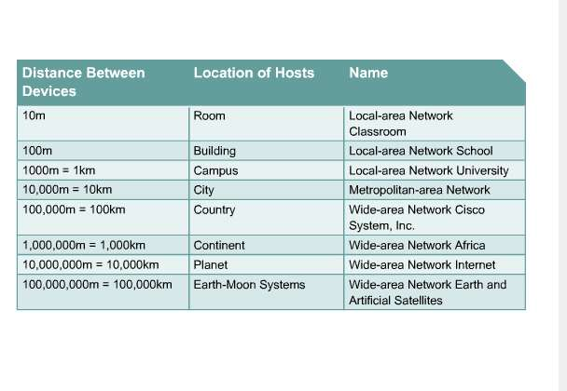

Slide 4
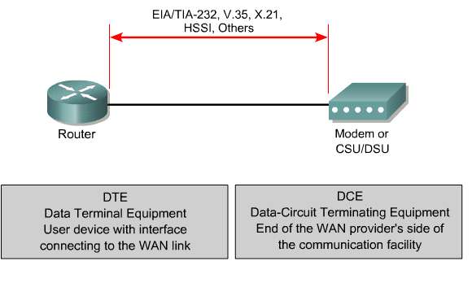
A CSU/DSU (Channel Service Unit/Data Service Unit) is a digital-interface device used to connect a DTE device, such as a router, to a digital circuit (e.g., a T1 or T3 line).
The WIC (WAN Interface Card) may contain an integrated CSU/DSU that can be inserted into a router slot

Slide 5
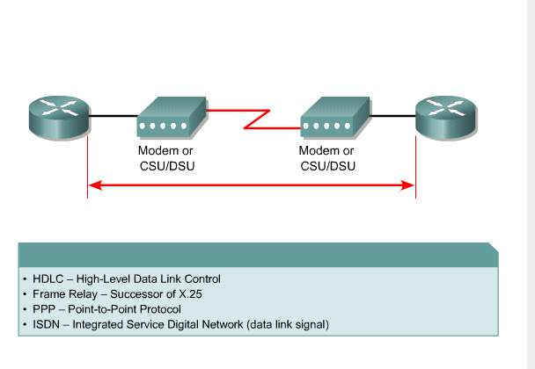
WAN data link protocols describe how frames are carried between systems on a single data link.

Slide 6
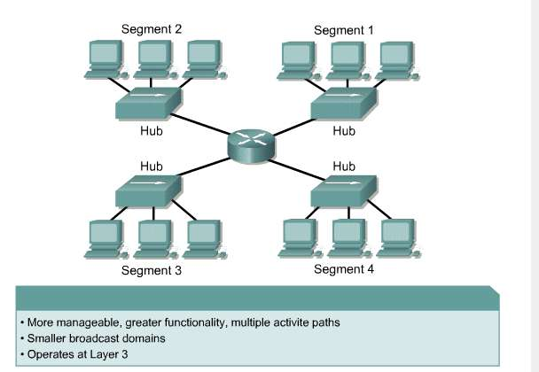
1.1.3 Router LANs and WANs

Slide 7
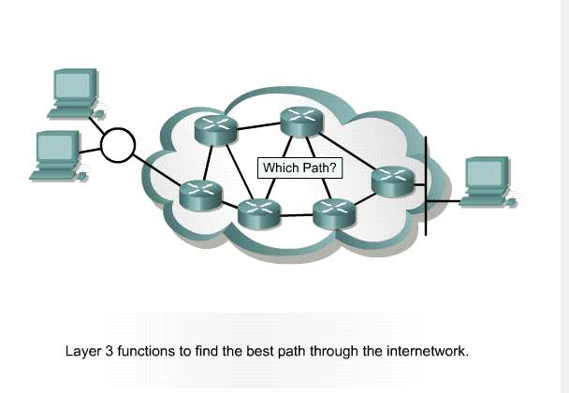

Slide 8
1.2 Routers

Slide 9
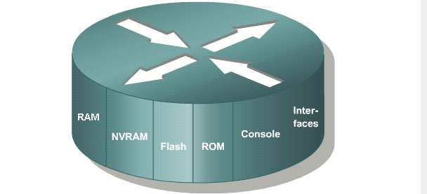
1.1.2 Introduction to routers
Like a PC
RAM | Stores routing tables, holds ARP cache, provides temporary memory for the configuration file. Loses content when a router is powered down or restarted
NVRAM | Provides storage for the startup configuration file Retains content when a router is powered down or restarted
Flash | Holds the IOS image Retains content when a router is powered down or restarted
ROM | Maintains instructions for power-on self test (POST) diagnostics Stores bootstrap program and basic operating system software Requires replacing pluggable chips on the motherboard for software upgrades
Console | Provide physical access for initial configuration
Interfaces | Connect routers to a network for packet entry and exit Can be on the motherboard or on a separate module

Slide 10
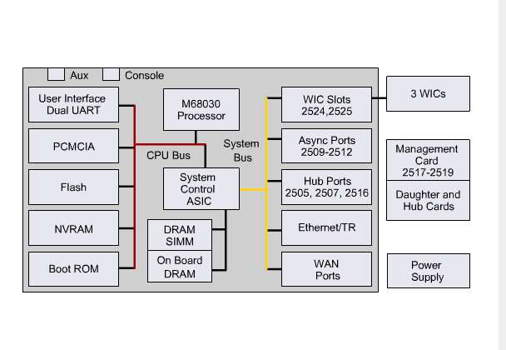
Router Internal Components

Slide 11
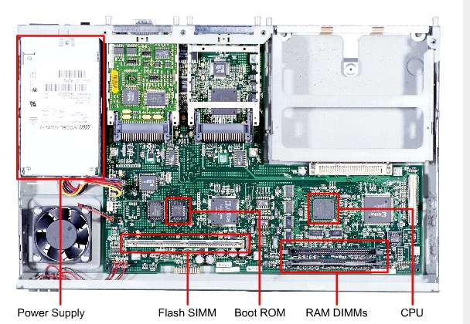
Internal Components of a 2600 Router

Slide 12
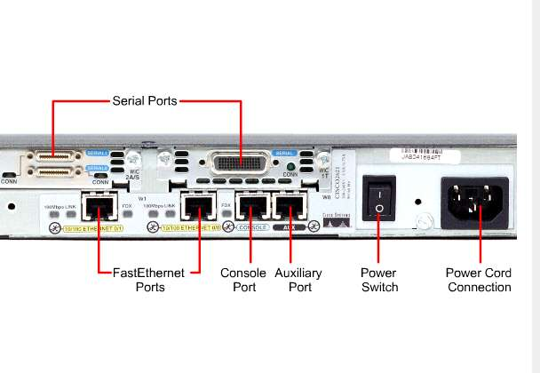
WAN Connections
LAN Connections
Management Port

Slide 13
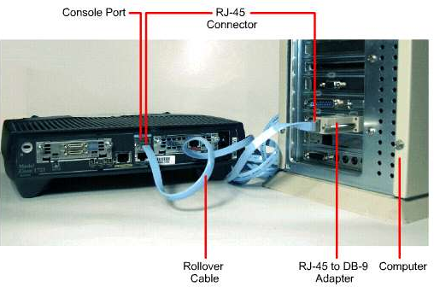
1.2.4 Management port connections
Computer Console connection

Slide 14
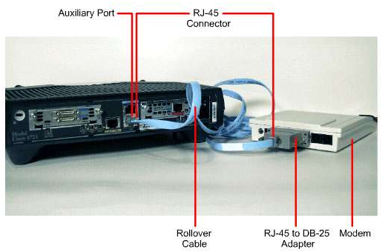
Modem Connection to Auxiliary Port

Slide 15
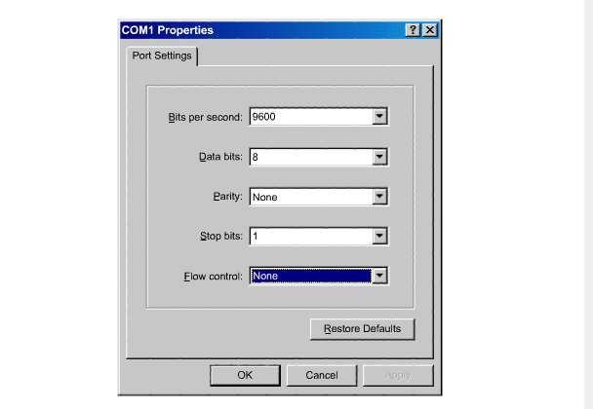
1.2.5 Console port connections

Slide 16
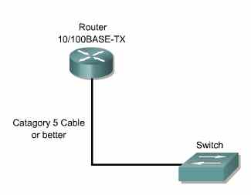
1.2.6 Connecting router LAN interfaces

Slide 17
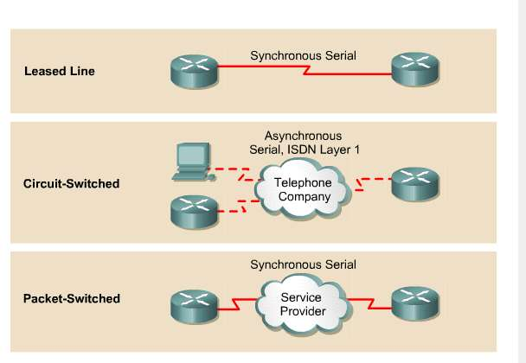
1.2.7 Connecting WAN interfaces

Slide 18
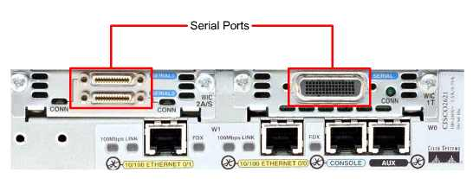
Different serial ports

Slide 19
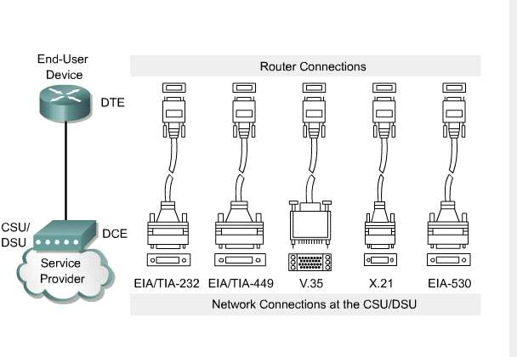
Different router connections

Slide 20
Part II Module 2: Introduction to Routers
Reference for CCNA 4:
2.1 Introduction to Routing and Packet Switching

Slide 21
2.1 Operating Cisco IOS Software

Slide 22
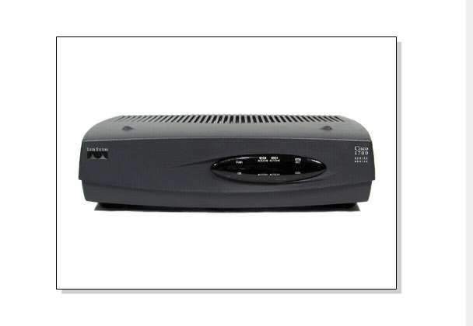
2.1.1 The purpose of Cisco IOS software
As with a computer, a router or switch cannot function without an operating system.
The Cisco IOS is the embedded software architecture in all of the Cisco routers and is also the OS of the Catalyst switches.

Slide 23
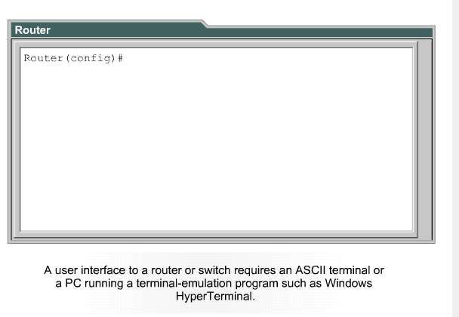
2.1.2 Router user interface
The CLI environment can be accessed several ways:
1. Through a console session.
2. Through a AUX port with a modem.
3. To Telnet to the router.
Neither of ways 1 and 2 require that the router have any IP services configured.
Way 3 requires at least one interface to be configured with an IP address.

Slide 24
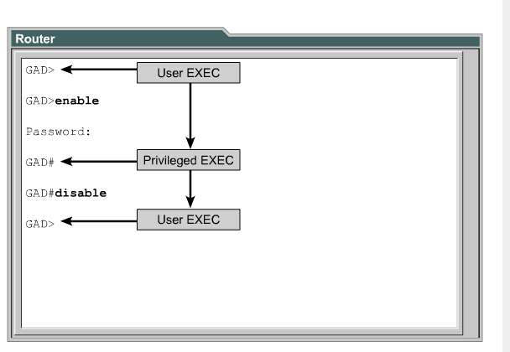
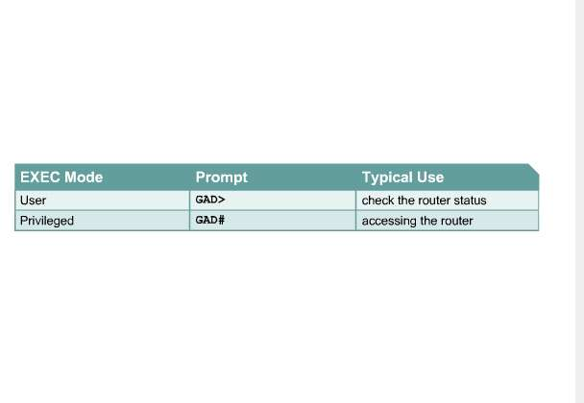
2.1.3 Router user interface modes

Slide 25
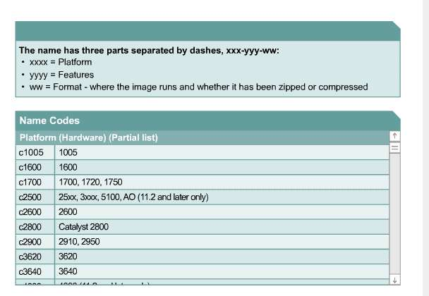
2.1.4 Cisco IOS software features
IOS Naming Conventions

Slide 26
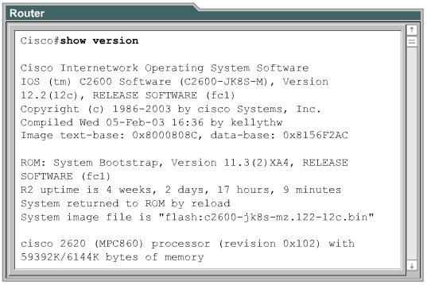
One of the main considerations when selecting a new IOS image is:
compatibility with the router flash and RAM memory.
In general, the newer the release and the more features that it provides, the more flash and RAM memory it requires.
Use show version to check the current image and available flash

Slide 27
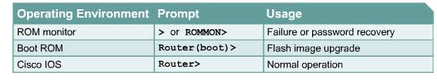
2.1.5 Operation of Cisco IOS software
The Cisco IOS devices have three distinct operating environments or modes:
1. ROM Monitor mode:
The ROM monitor performs the bootstrap process and provides low-level functionality and diagnostics.
It is used to recover from system failures and to recover a lost password.
It can only be accessed by way of a direct, physical connection through the console port.
2. Boot ROM mode:
Only a limited subset of the Cisco IOS feature set is available.
It allows write operations to flash memory.
It is used primarily to replace the Cisco IOS image that is stored in flash.
The Cisco IOS image can be modified in boot ROM with the copy tftp flash command.
3. Cisco IOS mode:
The normal operation of most Cisco routers require a copy of the IOS to be loaded into RAM and also executed from RAM.
Some IOS images are stored in flash in a compressed format and have to be expanded when copied to RAM.
A administrator can use the configuration register setting to control the default startup mode.
Like safe mode of Windows

Slide 28
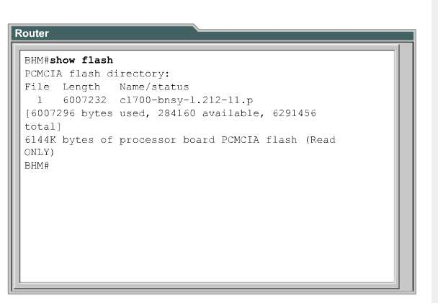
show version:
To see the IOS image and version that is running.
To see the the configuration register setting.
show flash:
To verify that the system has sufficient memory to load a new Cisco IOS image.

Slide 29
2.2 Starting a Router

Slide 30
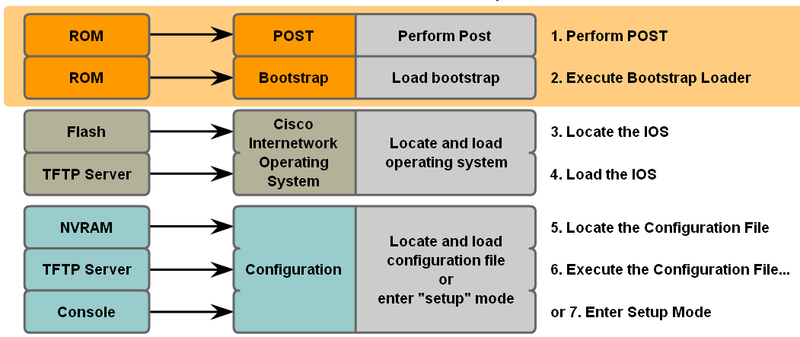
2.2.1 Initial startup of Cisco routers
POST:
When a Cisco router powers up, it performs a power-on self test (POST) to verify the basic operation of the CPU, memory, and network interface ports.
Bootstrap:
After the POST, the generic bootstrap loader in ROM executes.
A bootstrap is a simple set of instructions that tests hardware and initializes the IOS for operation.
Load IOS:
The IOS can be found in several places.
The boot field of the configuration register determines the location that is used to load the IOS.
Load configuration file:
When the IOS is loaded and operational, the configuration file saved in NVRAM is loaded into main memory and executed one line at a time.
If no valid configuration file exists in NVRAM, the operating system searches for an available TFTP server.
If no TFTP server is found, the setup dialog (setup mode)is initiated.
Upon completion of the setup mode, a backup copy of the configuration file may be saved to NVRAM.

Slide 31
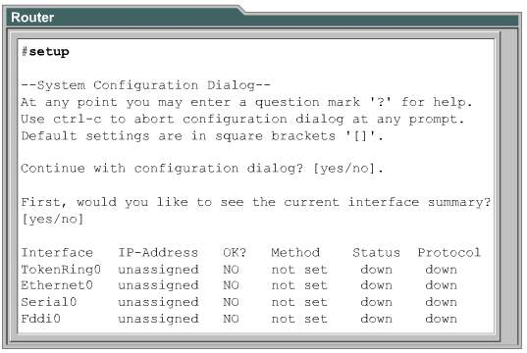
Setup mode
Setup mode is not intended to be used to enter complex protocol features in a router.
It is to permit administrators to install a basic configuration for routers.
In the setup mode, default answers appear in square brackets [ ] following the question.
Press the Enter key to use these defaults.
During the setup process, Ctrl-C can be pressed at any time to terminate the process.
When Ctrl-C is used to terminate setup, all interfaces are administratively shut down.
Like:
When you first install Windows.

Slide 32
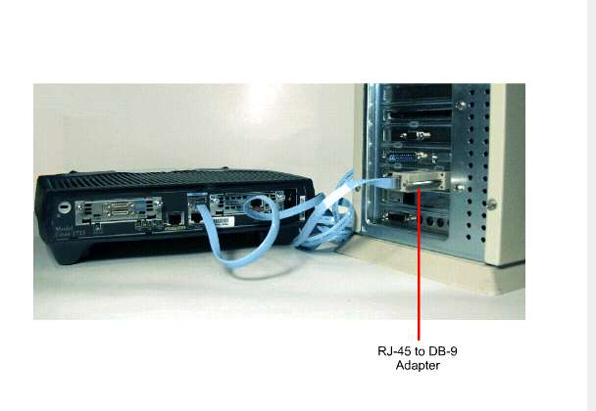
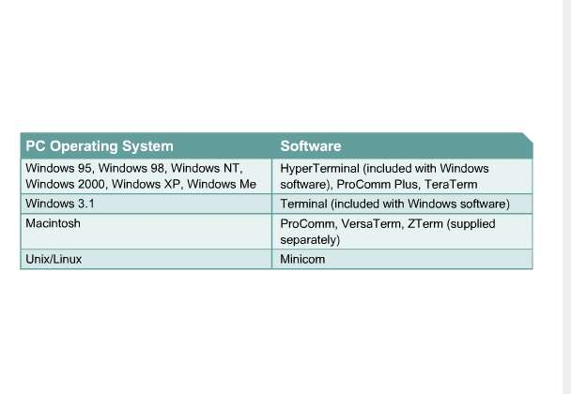
2.2.4 Establish a console session

Slide 33
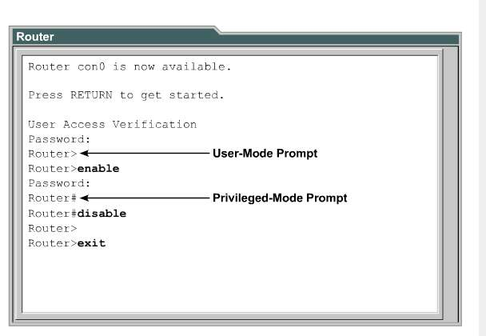
2.2.5 Router login
User EXEC mode – Typical tasks include commands that check the status of a router.
Privileged EXEC mode –Typical tasks include commands that change the router configuration.
Type “enable” to enter privileged mode
Type “disable” to exit privileged mode
Type “exit” or “end” or press Ctrl-Z to return to privileged mode from configuration mode

Slide 34
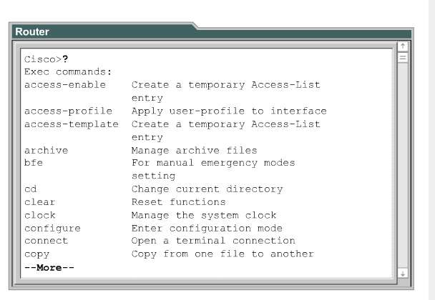
2.2.6 Keyboard help in the router CLI

Slide 35
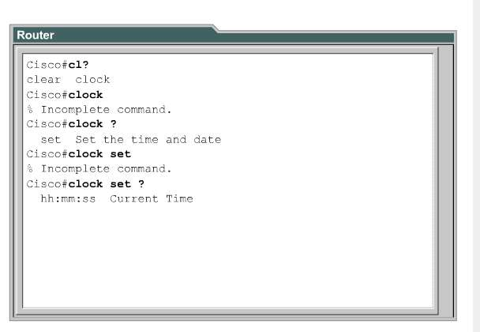

Slide 36
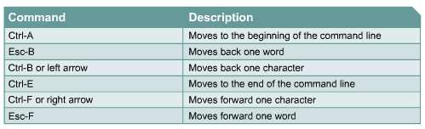
2.2.7 Enhanced editing commands

Slide 37
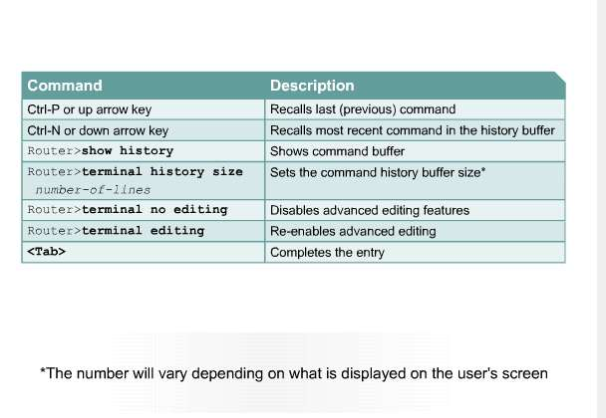
2.2.8 Router command history

Slide 38
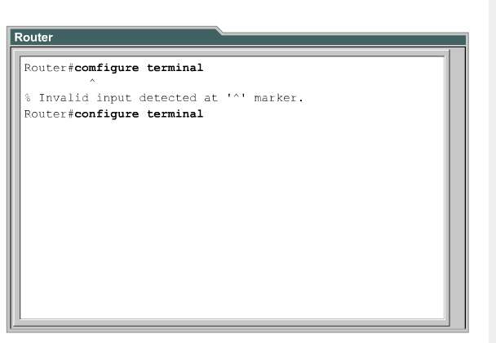
2.2.9 Troubleshooting command line errors

Slide 39
Part II Module 3: Configuring a Router
Reference for CCNA 4:
2.1 Introduction to Routing and Packet Forwarding

Slide 40
3.1 Configure a Router

Slide 41
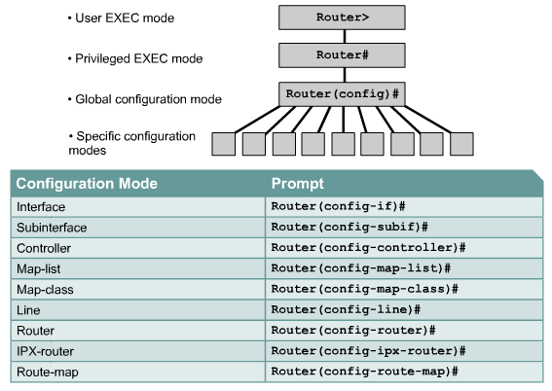
3.1.1 CLI command modes

Slide 42
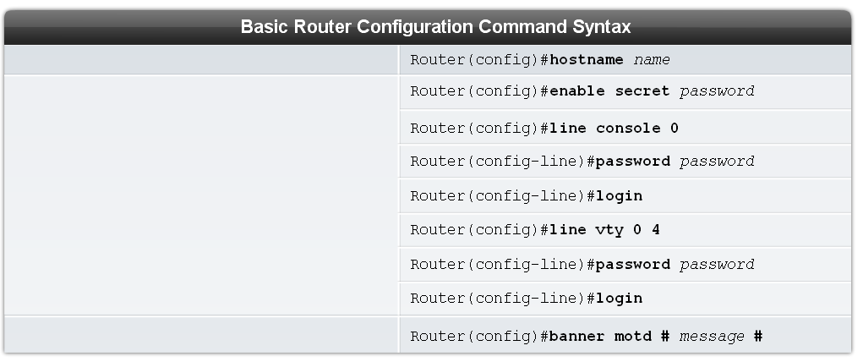
Two commands are used to restrict access to the privileged EXEC mode.
“enable password” : The passwords are shown in clear text in the configuration files.
“enable secret” : uses a strong MD5 algorithm for encryption

Slide 43
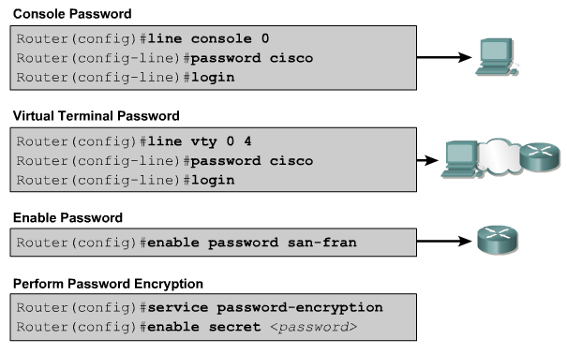
3.1.3 Configuring router passwords
“service password-encryption”: It applies a weak encryption to all unencrypted passwords.

Slide 44
3.1.4 Examining the show commands
show interfaces – Displays statistics for all interfaces on a router. :
show interfaces serial 0/1
show clock - Shows the time set in the router
show hosts - Displays a cached list of host names and addresses
show users - Displays all users who are connected to the router
show history - Displays a history of commands that have been entered
show flash - Displays information about flash memory and what IOS files are stored there
show version - Displays information about the currently loaded software version along with hardware and device information.
show arp - Displays the ARP table of the router
show protocols - Displays the global and interface-specific status of any configured Layer 3 protocols
show startup-config - Displays the saved configuration located in NVRAM
show running-config - Displays the contents of the currently running configuration file or the configuration for a specific interface, or map class information.

Slide 45
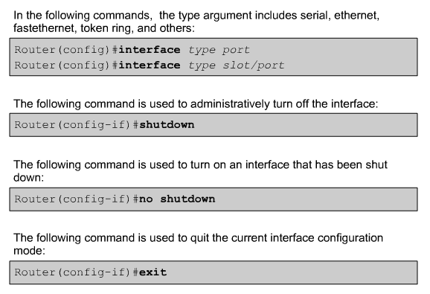
3.1.5 Configuring a serial interface
Router(config) # interface serial 0/0 Router(config-if) # clock rate 56000 Router(config-if) # no shutdown

Slide 46
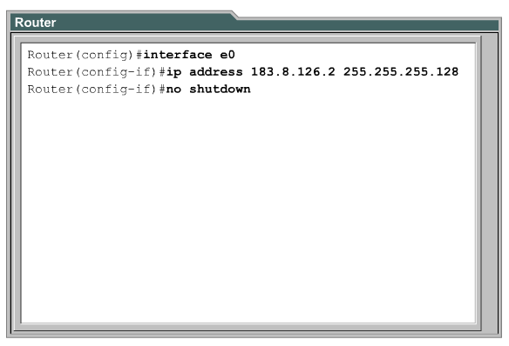
3.1.7 Configuring an Ethernet interface

Slide 47
3.2 Finishing the Configuration

Slide 48
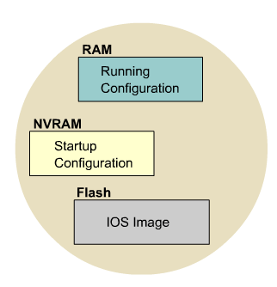
5.2.1 IOS file system overview
Network components in memory

Slide 49
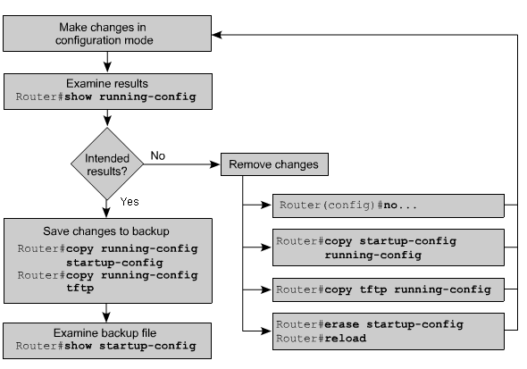
3.1.6 Making configuration changes

Slide 50
3.3 Other configuration

Slide 51
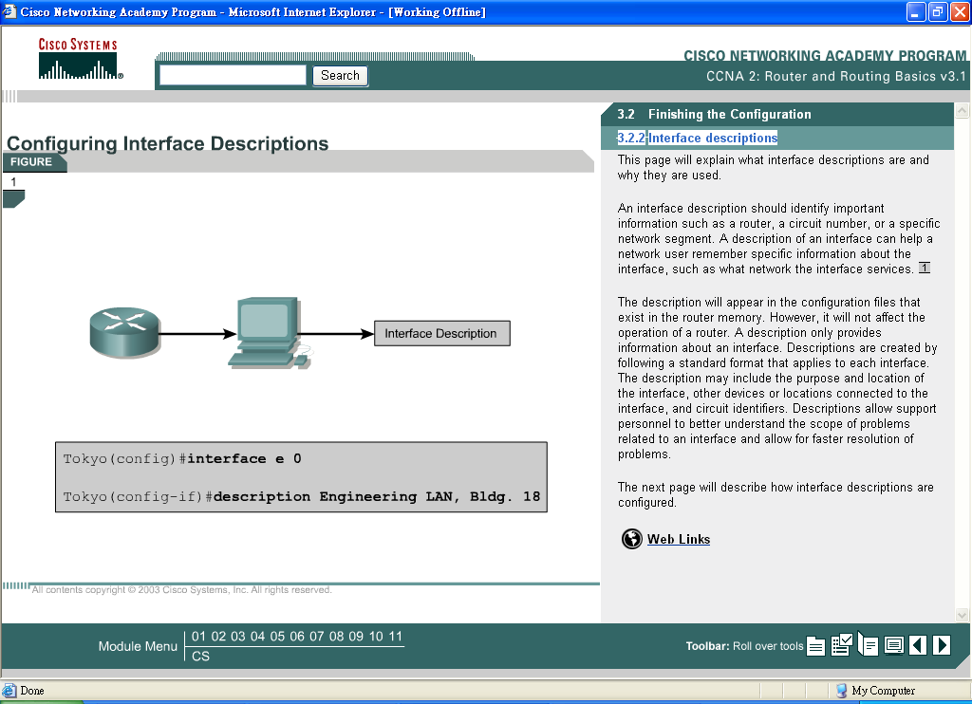
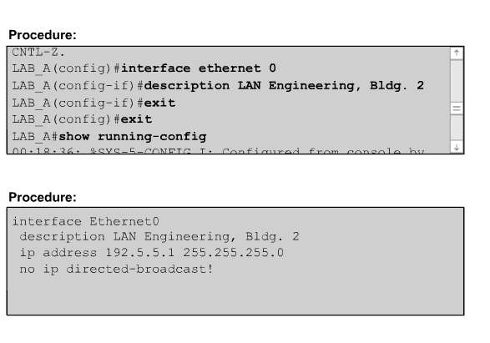
3.2.2 Interface descriptions
The “description” command

Slide 52
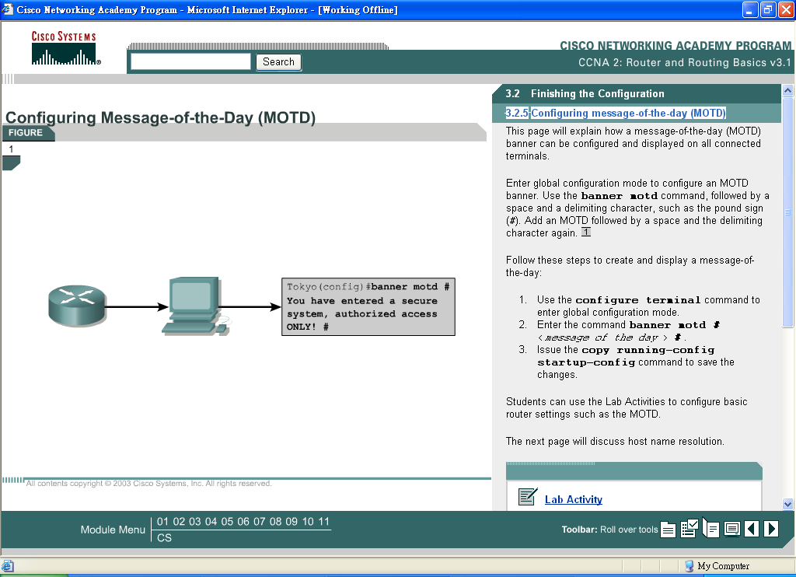
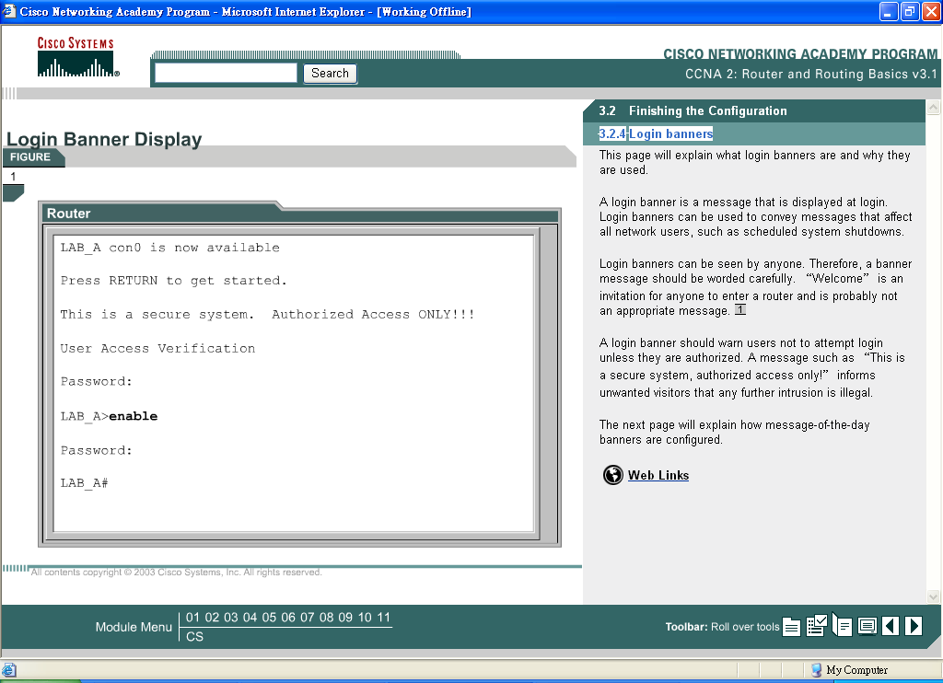
3.2.4 Login banners

Slide 53
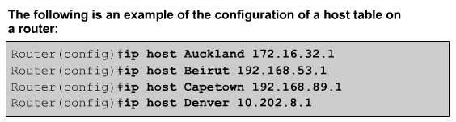
3.2.6 Host name resolution
Host names, unlike DNS names, are significant only on the router on which they are configured.

Slide 54
Part II Module 4 Learning about Other Devices
Reference for CCNA 4:
2.1 Introduction to Routing and Packet Forwarding

Slide 55
4.1 Discovering and Connecting to Neighbors

Slide 56
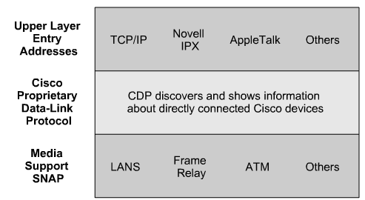
4.1.1 Introduction to CDP
Cisco Discovery Protocol (CDP) is used to obtain information about neighboring Cisco devices.
CDP Version 2 (CDPv2) is the most recent release of the protocol.
When a Cisco device boots up, CDP starts up automatically and allows the device to detect neighbor devices that use CDP.
CDP operates at the data link layer and allows two systems to learn about each other, even if they use different network layer protocols.
Each device that is configured for CDP sends periodic messages, which are known as advertisements, to directly connected Cisco devices

Slide 57
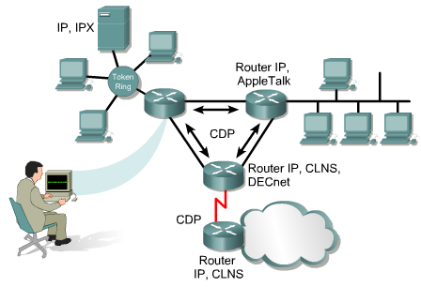
4.1.2 Information obtained with CDP
Each router that uses CDP exchanges protocol information with its neighbors.
The network administrator can display the results of this CDP information exchange on a console.

Slide 58
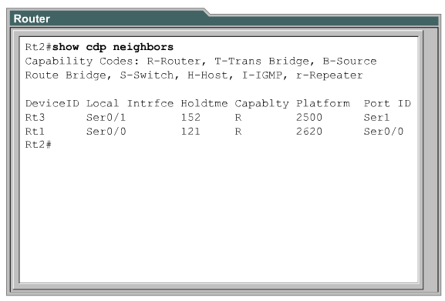

Slide 59
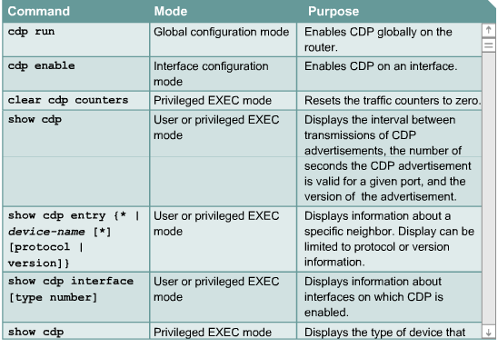
4.1.3 Implementation, monitoring, and maintenance of CDP
The “cdp run” command is used to enable CDP globally on a router. By default, CDP is globally enabled.
The “cdp enable” command is used to enable CDP on a particular interface.

Slide 60


Slide 61


Slide 62


Slide 63


Slide 64

4.1.5 Disabling CDP
no cdp run
cdp run

Slide 65
4.1.6
e-Lab Activity: CDP Neighbors

Slide 66
4.2 Getting Information about Remote Devices

Slide 67

4.2.1 Telnet

Slide 68

4.2.2 Establishing and verifying a Telnet connection
To initiate a Telnet session any of the following alternatives can be used:
Denver>connect paris
Denver>paris
Denver>131.108.100.152
Denver>telnet paris
A hostname table or access to DNS for Telnet must be present for a name to work. Otherwise, the IP address of the remote router must be entered.
A successful Telnet connection indicates that the upper-layer application functions properly.

Slide 69

4.2.3 Disconnecting and suspending Telnet sessions
link UNIX

Slide 70

4.2.5 Alternative connectivity tests

Slide 71


Slide 72
Part II Module 5: Managing Cisco IOS Software
Reference for CCNA 4:
2.1 Introduction to Routing and Packet Forwarding

Slide 73
5.1 Router Boot Sequence and Verification

Slide 74

5.1.1 Stages of the router power-on boot sequence

Slide 75

5.1.2 How a Cisco device locates and loads IOS

Slide 76

5.1.3 Using the boot system command
Boot IOS from flash memory

Slide 77
5.1.3
e-Lab Activity: Preparing for Boot System Commands
Step 6 – show running config – show the boot command

Slide 78


5.1.4 Configuration register
The order in which the router looks for system bootstrap information depends on the boot field setting in the configuration register.
The configuration register is a 16-bit register in NVRAM.
The lowest four bits of the configuration register form the boot field.
To ensure that the upper 12 bits are not changed, first use the show version command to retrieve the current values of the configuration register.
Then use the config-register command and change only the value of the last hexadecimal digit

Slide 79

Router (config)#>config-register 0x2140

Slide 80
5.2 Managing the Cisco File System

Slide 81
5.2.1 IOS file system overview
Network components in memory

Slide 82

A common set of prefixes

Slide 83


Slide 84

5.2.3 Managing configuration files using TFTP
Why router use TFTP

Slide 85


5.2.4 Managing configuration files using copy and paste
Copy
Paste
Another way to create a backup copy of the configuration is to capture the output of the show running-config command.

Slide 86

5.2.7 Environment variables
The IOS can also be restored from a TFTP session.
The fastest way to restore an IOS image to the router is to use TFTP from ROMmon to download the image.
To do this, set the environmental variables and then use the tftpdnld command.
Assign variable by “=“ sign. E.g.
type IP_ADDRESS=10.0.0.1
Use the set command to check the ROMmon environment variables.
Once the 5 variables are set for the IOS download, the tftpdnld command is entered with no arguments.

Slide 87


Slide 88
Part II Module 6 Routing and Routing Protocols
Reference for CCNA 4:
2.2 Static Routing
2.3 Introduction to Dynamic Routing Protocols

Slide 89

6.1.1 Introduction to routing

Slide 90


Slide 91


Slide 92

6.1.3 Configuring static routes
Using outgoing interface

Slide 93

6.1.3 Configuring static routes
-How many networks here?
-What is the configuration for Waycross?
Using a next-hop

Slide 94
Administrative Distance (AD)
waycross(config)#ip route 172.16.3.0 255.255.255.0 s1 130
Administrative distance (AD)
(static route=1, directly connect=0, 255 max)
A route with a lower administrative distance will be installed before a similar route with a higher administrative distance.
"show ip route" to verify AD
If an interface is down, the route will not be placed in the routing table.
Sometimes, a static route are used for backup purposes (when the dynamically learned route has failed).
It should has a higher AD than the dynamic routing protocol.

Slide 95
6.1.2
-e-Lab Activity: Static Route Operation
Description: step 3
The 255 will make this route the least desirable so that it will only be used when all other routes are unavailable.
This type of route is called a floating static route.
It floats in the router memory, but is not added to the routing table until all other rotes are unavailable.
-e-Lab Activity: Static Routes
Step by step, ask students why.

Slide 96

6.1.4 Configuring default route forwarding
Default routes are used to route packets with destinations that do not match any of the other routes in the routing table.
Using outgoing interface
Waycross(config)#ip route 0.0.0.0 0.0.0 172.16.4.1
Using next hop
Using outgoing interface
Sterling(config)#ip route 0.0.0.0 0.0.0 s0
Sterling(config)#ip route 0.0.0.0 0.0.0 172.16.2.2
Using next hop

Slide 97


6.1.5 Verifying static route configuration
- show ip route
- show running-config
You need to check both. Why? (some paths with lower AD is not shown in the routing table, but their configurations are shown in running-config.

Slide 98
6.2 Dynamic Routing Overview

Slide 99

6.2.1 Introduction to routing protocols
A routing protocol is the communication used between routers. Routers use this information to build and maintain routing tables.
A routed protocol provides enough information in its network layer address to allow a packet to be forwarded from one host to another based on the addressing scheme.

Slide 100

6.2.2 Autonomous systems
An AS is a collection of networks under a common administration that share a common routing strategy.
To the outside world, an AS is viewed as a single entity.
The American Registry of Internet Numbers (ARIN), a service provider, or an administrator assigns a 16-bit identification number to each AS.
Routing protocols, such as Cisco IGRP, require the assignment of a unique, AS number.

Slide 101

Routing protocols
RIP - a distance vector
IGRP - the Cisco distance vector
EIGRP - the advanced Cisco distance vector
OSPF - a link-state
BGP - a distance vector

Slide 102

6.2.3 Purpose of a routing protocol and autonomous systems
Converged
Whenever the topology of a network changes, the network knowledgebase must also change.
When all routers in an internetwork operate with the same knowledge, the internetwork is said to have converged.
Fast convergence is desirable because it reduces the period of time in which routers would continue to make incorrect routing decisions.
Dynamic Routing Operations

Slide 103

6.2.4 Identifying the classes of routing protocols
Distance vector
It determines the direction, or vector, and distance to any link in an internetwork.
Link-state
It recreates the exact topology of an entire internetwork.

Slide 104

6.2.5 Distance vector routing protocol features
Distance vector concept

Slide 105

6.2.5 Distance vector routing protocol features
Distance vector network discovery

Slide 106

Routing metric components

Slide 107

6.2.6 Link-state routing protocol features
Link-state concepts

Slide 108

Link-state topology changes

Slide 109

Link-state concerns

Slide 110
6.3 Routing Protocols Overview

Slide 111

6.3.1 Path determination
Network layer: path determination

Slide 112


Slide 113

6.3.1 Path determination

Slide 114

6.3.1 Path determination
Routing with network addressing

Slide 115

6.3.2 Routing configuration
IP routing configuration task
steps

Slide 116



6.3.2 Routing configuration
GAD(config)#router rip
GAD(config-router)#network 172.16.0.0

Slide 117


Slide 118
6.3.2
e-Lab Activity: Routing Configuration

Slide 119
Part II Module 7: Distance Vector Routing Protocol
Reference for CCNA 4:
2.4 Distance Vector Routing Protocols
2.5 RIPv1

Slide 120
7.1 Distance Vector Routing

Slide 121


Slide 122

7.1.1 Distance vector routing updates
Routing table updates occur periodically or when the topology in a distance vector protocol network changes.
It is important for a routing protocol to update the routing tables efficiently.
Distance vector algorithms call for each router to send its entire routing table to each of its adjacent neighbors.

Slide 123
RIP example
Initial
After exchange

Slide 124

7.1.2 Distance vector routing loop issues
The network is said to have converged if
All routers have consistent knowledge and correct routing tables.
Routing loops can occur when inconsistent routing tables are not updated due to slow convergence in a changing network.
Step 1
For Router C, the preferred path to Network 1 is by way of Router B, and the distance from Router C to Network 1 is 3.

Slide 125
When Network 1 fails, Router E sends an update to Router A. Router A stops routing packets to Network 1, but Routers B, C, and D continue to do so
When Router A sends out its update, Routers B and D stop routing to Network 1.
However, Router C has not received an update. For Router C, Network 1 can still be reached through Router B.
Step 3
Step 2

Slide 126
Now Router C sends a periodic update to Router D, which indicates a path to Network 1 by way of Router B.
Router D changes its routing table to reflect this incorrect information, and sends the information to Router A.
Step 4
(Via B)

Slide 127
Router A sends the information to Routers B and E, and the process continues.
Any packet destined for Network 1 will now loop from Router C to B to A to D and back to again to C.
Step 5
(Via B)
(Via C, B)

Slide 128

7.1.3 Defining a maximum count
With this approach, the routing protocol permits the routing loop to continue until the metric exceeds its maximum allowed value.

Slide 129

7.1.4 Elimination routing loops through split-horizon
If a routing update about Network 1 arrives from Router A, Router B or Router D cannot send information about Network 1 back to Router A.

Slide 130



Slide 131

7.1.6 Avoiding routing loops with triggered updates
New routing tables are sent to neighbor routers on a regular basis. For example, RIP updates occur every 30 seconds.
However a triggered update is sent immediately in response to some change in the routing table.
Triggered updates, used in conjunction with route poisoning (metric=16), ensure that all routers know of failed routes before any holddown timers can expire

Slide 132

7.1.7 Preventing routing loops with holddown timers
holddown timers can be used to avoid a count to infinity problem:
When a router receives an update from a neighbor, which indicates that a previously accessible network is now inaccessible, it marks the route as inaccessible and starts a holddown timer.
Before the holddown timer expires,
if | the router
an update is received from the same neighbor (indicates that the network is accessible) | marks the network as accessible and removes the holddown timer
an update arrives from a different neighbor router (with a better metric for the network) | marks the network as accessible and removes the holddown timer
an update is received from a different router with a higher (worse) metric | the update is ignored

Slide 133

7.1.8 Advantages and disadvantages of distance vector routing protocols

Slide 134
7.2 RIP

Slide 135

7.2.1 IP routing process
RIP includes a number of features that are common in other routing protocols. For example, RIP implements split horizon and holddown mechanisms to prevent the propagation of incorrect routing information

Slide 136

7.2.2 Configuring RIP
The router rip command enables RIP as the routing protocol.
The network command is then used to tell the router on which interfaces to run RIP.

Slide 137
10.0.0.0 , 1
10.0.0.0 , 2
RIP sends routing-update messages at regular intervals.
When a router receives a routing update that includes changes to an entry, it updates its routing table to reflect the new route.
The received metric value for the path is increased by 1, and the source interface of the update is indicated as the next hop in the routing table.
RIP routers maintain only the best route to a destination.
A configurable item that affects convergence time is the update interval. The default RIP update interval in Cisco IOS is 30 seconds.

Slide 138


7.2.6 Troubleshooting RIP update issues

Slide 139
7.2.2 e-Lab Activity: RIP

Slide 140
7.2.3 Using the ip classless command
Sometimes a router receives packets destined for an unknown subnet of a network that has directly connected subnets.
Use the ip classless global configuration command to instruct the Cisco IOS software to forward these packets to the best supernet route.
For example, if an enterprise uses the entire subnet 10.10.0.0 /16, then a supernet route for 10.10.10.0 /24 would be 10.10.0.0 /16.
The ip classless command is enabled by default in Cisco IOS Software Release 11.3 and later. To disable this feature, use the no form of this command.
When this feature is disabled any packets received that are destined for a subnet that falls within the subnetwork addressing scheme of the router will be discarded.
IP classless only affects the operation of the forwarding processes in IOS. IP classless does not affect the way the routing table is built.
10.10.0.0/16
5.5.0.0/16
s0 s1
To s0 or discard?
10.10.10.99/24
How about using default route?

Slide 141

The router only uses the default route if the major network destination does not exist in the routing table.
A router by default assumes that all subnets of a directly connected network should be present in the routing table.
If a packet is received with an unknown subnet of a directly attached network, the router assumes that the subnet does not exist.
So the router will drop the packet even if there is a default route.
To resolve this problem, configure ip classless on the router.

Slide 142



Slide 143

7.2.4 Common RIP configuration issues
Holddown timers help prevent counting to infinity but also increase convergence time.
The default holddown for RIP is 180 seconds.
This will prevent any inferior route from being updated but may also prevent a valid alternative route from being installed.
The holddown timer can be decreased to speed up convergence but should be done with caution.
Ideally, the timer should be set just longer than the longest possible update time for the internetwork.
In the example in Figure, the loop consists of four routers. If each router has an update time of 30 seconds, the longest loop would be 120 seconds. Therefore, the holddown timer should be set to slightly more than 120 seconds.

Slide 144




Slide 145


7.2.5 Verifying RIP configuration

Slide 146



Slide 147

7.2.7 Preventing routing updates through an interface
the passive-interface command prevents the transmission of routing updates through a router interface, but the router continues to listen and use routing updates from that neighbor.

Slide 148

7.2.8 Load balancing with RIP
RIP is capable of load balancing over as many as six equal-cost paths.
The default is four paths. RIP performs what is referred to as “round robin” load balancing.
Since the metric for RIP is hop count, the speed of the links is not considered. So, the 56-Kbps path will be given the same preference as the 155-Mbps path.

Slide 149

7.2.9 Load balancing across multiple paths
When a router learns multiple routes to a specific network, the route with the lowest administrative distance is installed in the routing table.

Slide 150

If same AD, the path with lowest cost will be chosen.
E.g., Router E chooses the second path, since 20 < 30 and 45.
If there’re paths with the same AD and cost, load-balancing can occur.
(The costs may need to be manually configured in order to achieve load balancing.)
Cisco IOS imposes a limit of up to six equal cost routes in a routing table, but some IGPs have their own limitations.
EIGRP allows up to four equal cost routes.
Router(config-router)# maximum-paths [number ]

Slide 151
Two methods of load balancing for IP packets.
per-packet:
the router will alternate paths on a per-packet basis.
per-destination:
All packets that are bound for a specific host will take the same path.
Packets bound for a different host on the same network may use an alternate route.
By default the router uses per-destination load balancing, also called fast switching.
To disable fast switching, use the no ip route-cache command.
Using this command will cause traffic to be load balanced on a per-packet basis.

Slide 152
7.2.9 e-Lab Activity: Load Balancing Across Multiple Paths

Slide 153


7.2.10 Integrating static routes with RIP
The static route is assigned a higher AD on purpose.

Slide 154


S 172.16.0.0/16 [130/1]

Slide 155
7.3 IGRP

Slide 156

7.3.1 IGRP features
By default, the IGRP routing protocol uses bandwidth and delay as metrics.
Additionally, IGRP can be configured to use a combination of variables to determine a composite metric. These variables are as follows:
Bandwidth
Delay
Load
Reliability

Slide 157
When Cisco created IGRP in the early 1980s, it was the first company to solve the problems associated with the use of RIP to route datagrams between interior routers.
IGRP examines the bandwidth and delay of the networks between routers to determine the best path through an internetwork.
IGRP converges faster than RIP. This prevents routing loops that are caused by disagreement over the next routing hop.
Further, IGRP does not share the hop count limitation of RIP.
As a result of this and other improvements over RIP, IGRP enabled many large, complex, topologically diverse internetworks to be deployed.

Slide 158


Slide 159

7.3.2 IGRP metrics
$$Metric=\left[K1×bandwidth+\frac{K2×bandwidth}{256−load}+K3×delay\right]\left[\frac{K5}{reliability+K4}\right]$$
The default constant values are K1 = K3 = 1 and K2 = K4 = K5 = 0.
If K5 = 0, the [K5/(reliability + K4)] term is not used. So, given the default values for K1 through K5, the composite metric calculation used by IGRP reduces to Metric = Bandwidth + Delay.

Slide 160

the IGRP metric values

Slide 161
7.3.4 IGRP stability features
Holddowns
Split horizons
Poison reverse updates

Slide 162



7.3.5 Configuring IGRP
Enable & disable
All routers in the same AS
AS correction

Slide 163


7.3.7 Verifying IGRP configuration

Slide 164

7.3.8 Troubleshooting IGRP

Slide 165
Part II Module 8: TCP/IP Suite Error and Control Messages

Slide 166
8.1 Overview of TCP/IP Error Message

Slide 167
8.1.1 ICMP
IP is a best effort delivery system.
It has no mechanism to ensure that data is delivered over a network.
Data may fail to reach its destination for a variety of reasons such as:
hardware failure
improper configuration, or
incorrect routing information.
To help identify these failures, IP uses the Internet Control Message Protocol (ICMP) to notify the sender of the data that there was an error in the delivery process.
ICMP does not overcome the unreliability issues in IP.
Reliability is provided by upper layer protocols.

Slide 168

8.1.2 Error reporting and error correction
Workstation 1 tries to send a datagram to Workstation 6, but Fa0/0 on Router C goes down.
Router C uses ICMP to send a message back to Workstation 1. The message indicates that the datagram could not be delivered.
ICMP does not correct any network problems that it encounters, it only reports them.
When Router C receives the datagram from Workstation 1, it knows only the source and destination IP addresses of the datagram. It does not know the exact path that the datagram took. Therefore, Router C can only notify Workstation 1 of the failure and no ICMP messages are sent to Router A and Router B.

Slide 169

8.1.3 ICMP message delivery
ICMP messages are encapsulated into datagrams in the same way any other data is delivered when IP is used.
Since ICMP messages are transmitted in the same way as any other data, they are subject to the same delivery failures. This creates a scenario where error reports could generate more error reports and cause increased congestion on a network. For this reason, errors created by ICMP messages do not generate their own ICMP messages.

Slide 170

8.1.4 Unreachable networks
e.g.,
a non-existent IP address or to a destination device that is disconnected from its network

Slide 171

8.1.5 Use ping to test destination reachability
The ICMP protocol can be used to test the availability of a particular destination.
The echo request message is typically initiated with the ping command

Slide 172

8.1.6 Detecting excessively long routes
Whether the actual path includes a circular routing path or too many hops, the packet will eventually exceed the maximum hop count, resulting in unreachable destinations.

Slide 173
8.2 ICMP Messages

Slide 174


Type 0, 8: Echo messages
type and code
identifier and sequence number
are unique to the echo request and echo reply messages.
are used to match the echo replies to the corresponding echo request.
data
contains additional information that may be a part of the echo reply or echo request message.

Slide 175

Type 3: Destination unreachable message
Datagrams cannot always be forwarded to their destinations. E.g.,
Hardware failures, improper protocol configuration, down interfaces, and incorrect routing information

Slide 176


an ICMP destination unreachable message header:
type = 3
code = the unreachable reason. See table.
To effectively troubleshoot an IP network, it is necessary to understand the various
causes of ICMP destination unreachable messages.

Slide 177

Type 5: Redirect/change requests
Normally, Host B is connected to a single gateway.
However, a host may be connected to a segment that has two or more directly connected routers.
In this case, the default gateway of the host may need to use a redirect/change request to inform the host of the best path to a certain network.

Slide 178

Host B sends a packet to Host C on network 10.0.0.0/8.
Since Host B is not directly connected to the same network, it forwards the packet to its default gateway, Router A.
Router A finds the correct route to network 10.0.0.0/8 by looking into its route table. It determines that the path to the network is back out the same interface the request to forward the packet came from.
It forwards the packet and sends an ICMP redirect/change request to Host B. The request instructs Host B to use Router B as the gateway to forward all future requests to network 10.0.0.0/8.
Default gateways only send ICMP redirect/change request messages if the following conditions are met:
The interface on which the packet comes into the router is the same interface on which the packet gets routed out.
The subnet/network of the source IP address is the same subnet/network of the next-hop IP address of the routed packet.
The datagram is not source-routed.
The route for the redirect is not another ICMP redirect or a default route.
The router is configured to send redirects. By default, Cisco routers send ICMP redirects. The interface subcommand no ip redirects will disable ICMP redirects.

Slide 179

Type 13, 14: Clock synchronization and transit time estimation
type
13 =a timestamp request or 14 =a timestamp reply.
code
always set to 0 because there are no additional parameters available.
originate timestamp
the time on the requesting host just before the timestamp request is sent.
receive timestamp
the time that the destination host receives the ICMP timestamp request.
transmit timestamp
is filled in just before the ICMP timestamp reply is returned.
While ICMP timestamp messages provide a simple way to estimate time on a remote host and total network transmit time, this is not the best way to obtain this information. Instead, more robust protocols such as Network Time Protocol (NTP) at the upper layers of the TCP/IP protocol stack perform clock synchronization in a more reliable manner.

Slide 180
5.3 Traceroute

Slide 181
Traceroute sends out a sequence of UDP datagrams from the router to an invalid port address on the remote host. For the first sequence of three datagrams, a TTL field value is set to 1. The TTL value of 1 causes the datagram to time out at the first router in the path. This router then responds with an ICMP Time Exceeded Message (TEM) indicating that the datagram has expired.
Three more UDP messages are now sent, this time with the TTL value set to 2. This causes the second router to return ICMP TEMs. This process continues until the packets actually reach the other destination or the maximum TTL has been reached. The default maximum TTL for traceroute is 30.
Since these datagrams are trying to access an invalid port at the destination host, ICMP Port Unreachable Messages are returned instead of ICMP TEMs. This indicates an unreachable port and signals the Traceroute program to end the process.

Slide 182



Slide 183
Part II Module 9: Basic Router Troubleshooting

Slide 184
show ip route
To gather detailed information about the routes installed on the router
ping
To perform basic network connectivity tests
telnet
To verify the application layer software between source and destination stations
show interfaces
To confirm Layer 1 and Layer 2 problems
show ip route and show ip protocol
To identify routing issues
show cdp
To verify Layer 2 connectivity
traceroute
to identify the path packets take between networks
show controllers serial
ensure the proper cable is attached
debug
to monitor router activity

Slide 185
9.1 Examining the Routing Table

Slide 186

9.1.1 The show ip route command
additional commands that can be used with the show ip route command:
show ip route connected
show ip route address
show ip route rip
show ip route igrp
show ip route static

Slide 187

9.1.2 Determining the gateway of last resort
or
ip route 0.0.0.0 0.0.0.0 192.168.17.0

Slide 188


Slide 189

9.1.4 Determining L2 and L3 addresses
Do Interactive Media Activity

Slide 190

9.1.5 Determining the route administrative distance

Slide 191

show ip route
show ip route address
show ip protocols
show ip rip database
9.1.8 Determining the last routing update

Slide 192


Slide 193


Slide 194

9.1.9 Observing multiple paths to destination
IGRP supports unequal cost path load balancing, which is known as variance.
The variance command instructs the router to include routes with a metric less than n times the minimum metric route for that destination.
The variable n can take a value between 1 and 128, with the default being 1, which means equal cost load balancing.
E-B-A with a metric of 30
E-C-A with a metric of 20
E-D-A with a metric of 45
Router E chooses the path E-C-A with a metric of 20 (as 20 is better than 30 and 45).
Configure variance with a multiplier of 2 =
increases the minimum metric to 40 (2 * 20 = 40).
IGRP includes all routes that have a metric of less than 40.
IGRP now uses two paths to get to Network X, E-C-A and E-B-A, because both paths have a metric of under 40.

Slide 195


the output from show ip route from rt1 before the variance is configured.
the output from show ip route from rt1 after the variance is configured.
The preferred route is interface FastEthernet 0/0, but Serial 0/0 will also be used. After the variance command is executed, IGRP will use load balancing between the two links

Slide 196
9.2 Network Testing

Slide 197

9.2.2 Using a structured approach to troubleshooting

Slide 198


Slide 199
9.2.3 Testing by OSI layers
Layer 1 errors can include the following:
Broken cables
Disconnected cables
Cables connected to the wrong ports
Intermittent cable connection
Rollover, crossover, or straight-through cables used incorrectly
Transceiver problems
DCE cable problems
DTE cable problems
Devices turned off
Layer 2 errors can include the following:
Improperly configured serial interfaces
Improperly configured Ethernet interfaces
Improper encapsulation set
Improper clockrate settings on serial interfaces
Network interface card (NIC) problems
Layer 3 errors can include the following:
Routing protocol not enabled
Wrong routing protocol enabled
Incorrect IP addresses
Incorrect subnet masks

Slide 200


9.2.5 Layer 3 troubleshooting using ping

Slide 201

9.2.6 Layer 7 troubleshooting using Telnet
A successful Telnet connection
indicates that the upper-layer application and the services of lower layers are functioning properly
If an administrator can Telnet to one router but not to another router,
verify lower layer connectivity. If connectivity has been verified, it is likely that the Telnet failure is caused by specific addressing, naming, or access permission problems.

Slide 202
9.3 Troubleshooting Router Issues Overview

Slide 203

9.3.1 Troubleshooting Layer 1 using show interfaces
The 1st parameter, which is line, refers to the physical layer
The 2nd parameter considers protocol,
When the line is down, the protocol is always down.
If the interface is down, a hardware problem exists, or it is administratively down.
If the interface is up and the protocol is down, a Layer 2 problem exists. E.g.,
No keepalives (after missing 3 consecutive keepalives, the protocol is marked as down.
No clock rate
Mismatch in encapsulation type

Slide 204

9.3.3 Troubleshooting using show cdp
This information is useful for debugging connectivity issues.
If a cabling problem is suspected,
enable the interfaces with the no shutdown command and then
execute the show cdp neighbors detail command before any other configuration.
If no known device appears, this usually indicates a Layer 1 problem.
One area of concern with CDP is security.
The amount of information CDP provides is so extensive that it can be a potential security hole.
For security reasons CDP should be configured only on links between Cisco devices and disabled on user ports or links that are not locally managed.

Slide 205

9.3.4 Troubleshooting using traceroute
If an asterisk (*) appears, the packet failed.
The round trip time (RTT) is the time required to send an echo packet and get a response.
A failed response is not always an indication of a problem because ICMP messages could be rate-limited or filtered at the host site.

Slide 206

9.3.6 Troubleshooting using show controllers
the show controllers command produces a large amount of output. Other than the cable type, most of this output is internal technical detail about the controller chip status. Without specific knowledge of the integrated circuit, this information is of little use

Slide 207

9.3.7 Introduction to debug
WARNING: The debug all command should be used sparingly as this can disrupt router operations.

Slide 208


Slide 209


Slide 210


Slide 211
Part II Module 11: Access Control List (ACLs)
Reference for CCNA 4:
4.5 ACLs

Slide 212
11.1 Access Control List Fundamentals

Slide 213

11.1.1 Introduction to ACLs
ACLs tell the router what types of packets to accept or deny.
Acceptance and denial can be based on specified conditions.
ACLs can be used to:
Provide a basic level of security for network access.
E.g., Host A is allowed to access the Human Resources network and Host B is prevented from accessing it.
Decide which types of traffic are forwarded or blocked at the router interfaces.
ACLs can permit e-mail traffic to be routed, but block all Telnet traffic.
Control which areas a client can access on a network.

Slide 214

An ACL makes routing decisions based on
source address,
destination address,
protocols, and
upper-layer port numbers.

Slide 215

ACLs must be defined on a per protocol, per direction, or per port basis.

Slide 216


A sample ACL
11.1.2 How ACLs work
source=172.16.1.1
R
same number = same list
Here: This ACL consists of 4 statements
The order in which ACL statements are placed is important.
Once a match is found in the list, the accept or reject action is performed and no other ACL statements are checked.

Slide 217

If additional condition statements are needed in an access list, the entire ACL must be deleted and recreated with the new condition statements.
To make the process of revising an ACL simpler it is a good idea to use a text editor such as Notepad and paste the ACL into the router configuration.

Slide 218



ACL and Routing Processes in a Router

Slide 219

11.1.3 Creating ACLs
There are many types of ACLs.
When ACLs are configured on a router, each ACL must have a unique identification number assigned to it.
Example

Slide 220



Slide 221

can 172.16.1.1 go?
can 172.16.1.2 go?
can 172.16.0.2 go?
can 172.15.0.1 go?
can 222.15.0.1 go?
What’s the list type?
This is wildcard not subnet mask
An ACL containing numbered ACL statements cannot be altered.
It must be deleted by using the no access-list list-number command and then recreated.

Slide 222
ACLs must be defined on a per protocol, per direction, or per port basis.

Slide 223

0 = a value that will be checked.
1 = to block values.
11.1.4 The function of a wildcard mask

Slide 224

1
0

Slide 225


Slide 226

11.1.5 Verifying ACLs

Slide 227


Slide 228


Slide 229
11.2 Access Control Lists (ACLs)

Slide 230


11.2.1 Standard ACLs

Slide 231

The remark keyword makes the access list easier to understand.
Each remark is limited to 100 characters. E.g.,
Router(config)#access-list 1 permit 171.69.2.88
Can be written to
Router(config)#access-list 1 remark Permit only Jones workstation through access-list 1 permit 171.69.2.88

Slide 232



11.2.2 Extended ACLs

Slide 233


Slide 234

Extended ACLs check:
source addresses
destination addresses
protocols
port numbers.
So, e.g., an extended ACL can simultaneously allow e-mail traffic from Fa0/0 to specific S0/0 destinations and deny file transfers and Web browsing.
Protocol, src IP, src mask, dest ip, operator, port

Slide 235


Slide 236


11.2.3 Named ACLs
Named ACLs allow standard and extended ACLs to be given names instead of numbers.
test

Slide 237


Advantages that are provided by a named access list:
Alphanumeric names can be used to identify ACLs.
The IOS does not limit the number of named ACLs that can be configured.
Named ACLs provide the ability to modify ACLs without deletion and reconfiguration. However, a named access list will only allow for statements to be inserted at the end of a list.
Named ACLs are not compatible with Cisco IOS releases prior to Release 11.2
The same name may not be used for multiple ACLs.
E.g., it is not permissible to specify both a standard and extended ACL named George.

Slide 238


Slide 239

11.2.4 Placing ACLs
Proper ACL placement will filter traffic and make the network more efficient.
The ACL should be placed where it has the greatest impact on efficiency.
The general rule is:
1. Put the extended ACLs as close as possible to the source of the traffic denied.
2. Standard ACLs do not specify destination addresses, so they should be placed as close to the destination as possible.
E.g., a standard ACL should be placed on Fa0/0 of Router D to prevent traffic from Router A
The administrator wants to deny Telnet traffic from the LAN A to LAN D.
Place this extended ACL in Router A.
Then, packets do not have to cross the Router A, B, C and D.
Block telnet traffic to D
LAN A
LAN D

Slide 240

11.2.6 Restricting virtual terminal access
Only numbered access lists can be applied to virtual lines.
Identical restrictions should be set on all the virtual terminal lines, because a user can attempt to connect to any of them.

